Slide 1
Bobcat Enrichment Facility
???
Maryland Zoo

Slide 2
Overview
Can also be adapted to other animals (such as elephants).
For now, adjusting audio volume and type is not working.

Slide 3
Build your own facility
Step-by-step

Slide 4
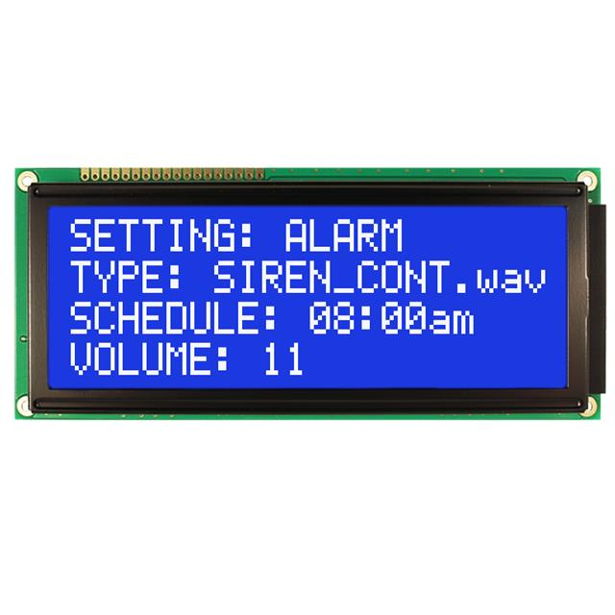
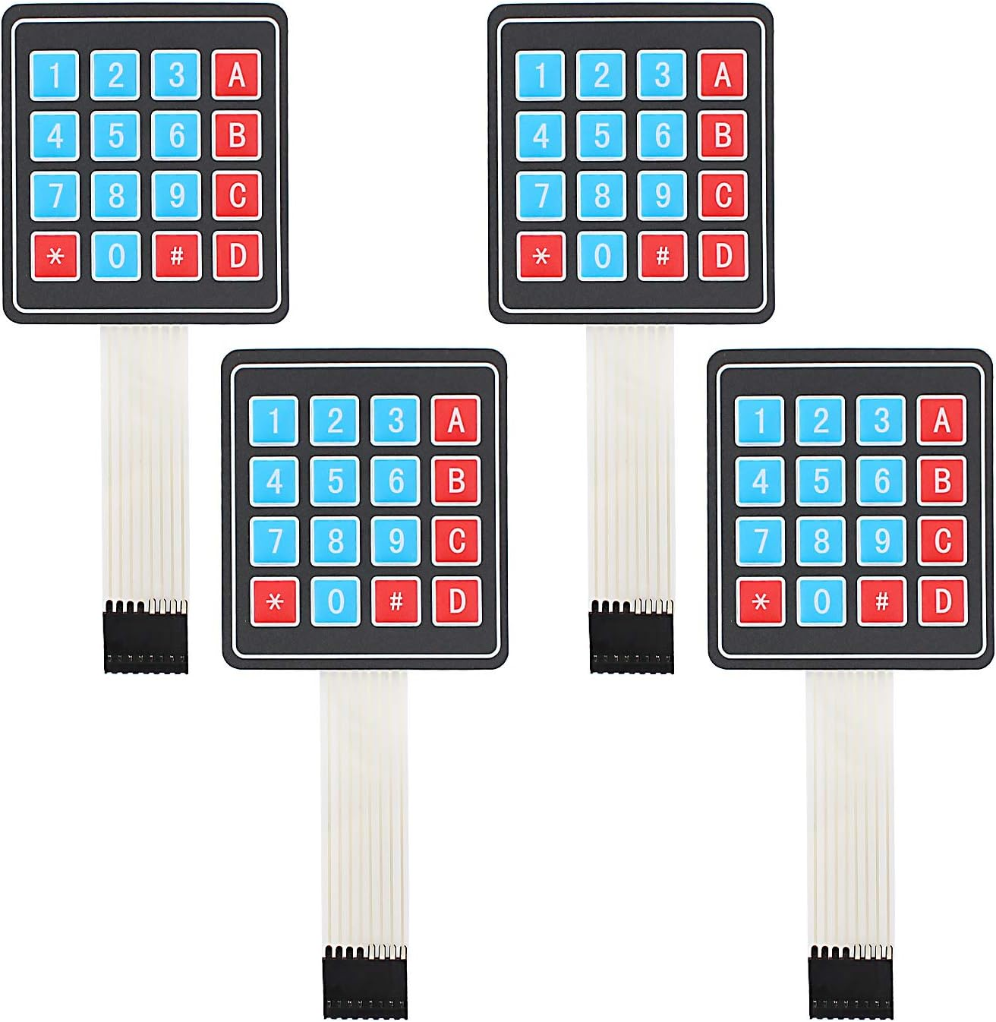

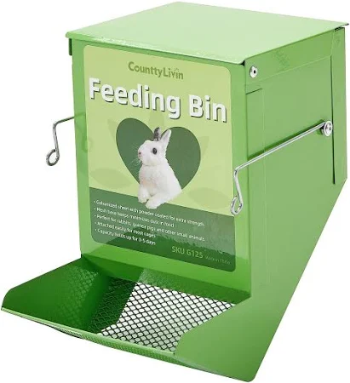
Network & Connections
Coordinator
Wireless
Detector #1
Detector #n
Feeder #n+1
Feeder #n+m
…
…
Build your own enrichment facility.
Add as many detector and feeder devices as you need.

Slide 5
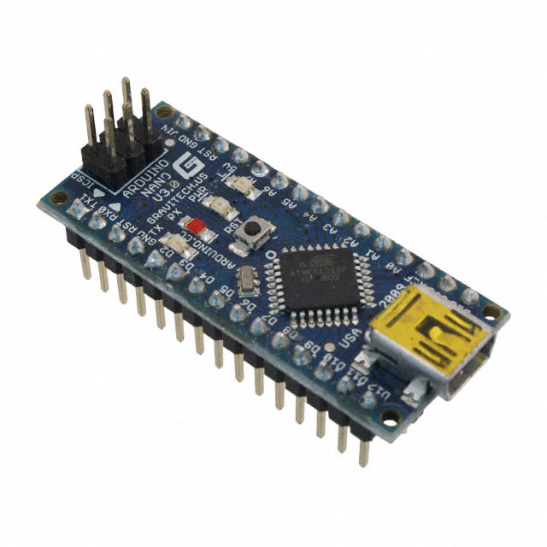
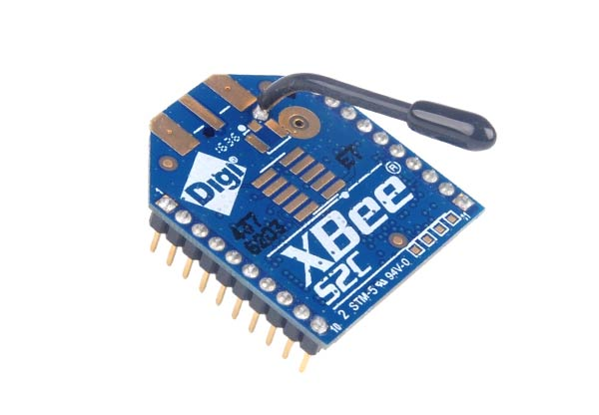
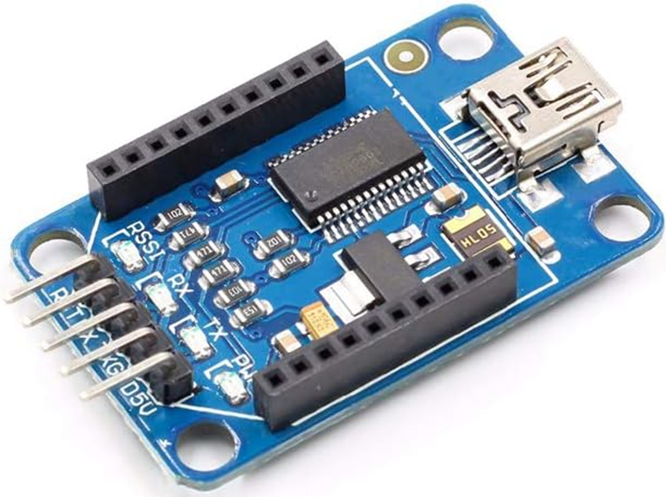
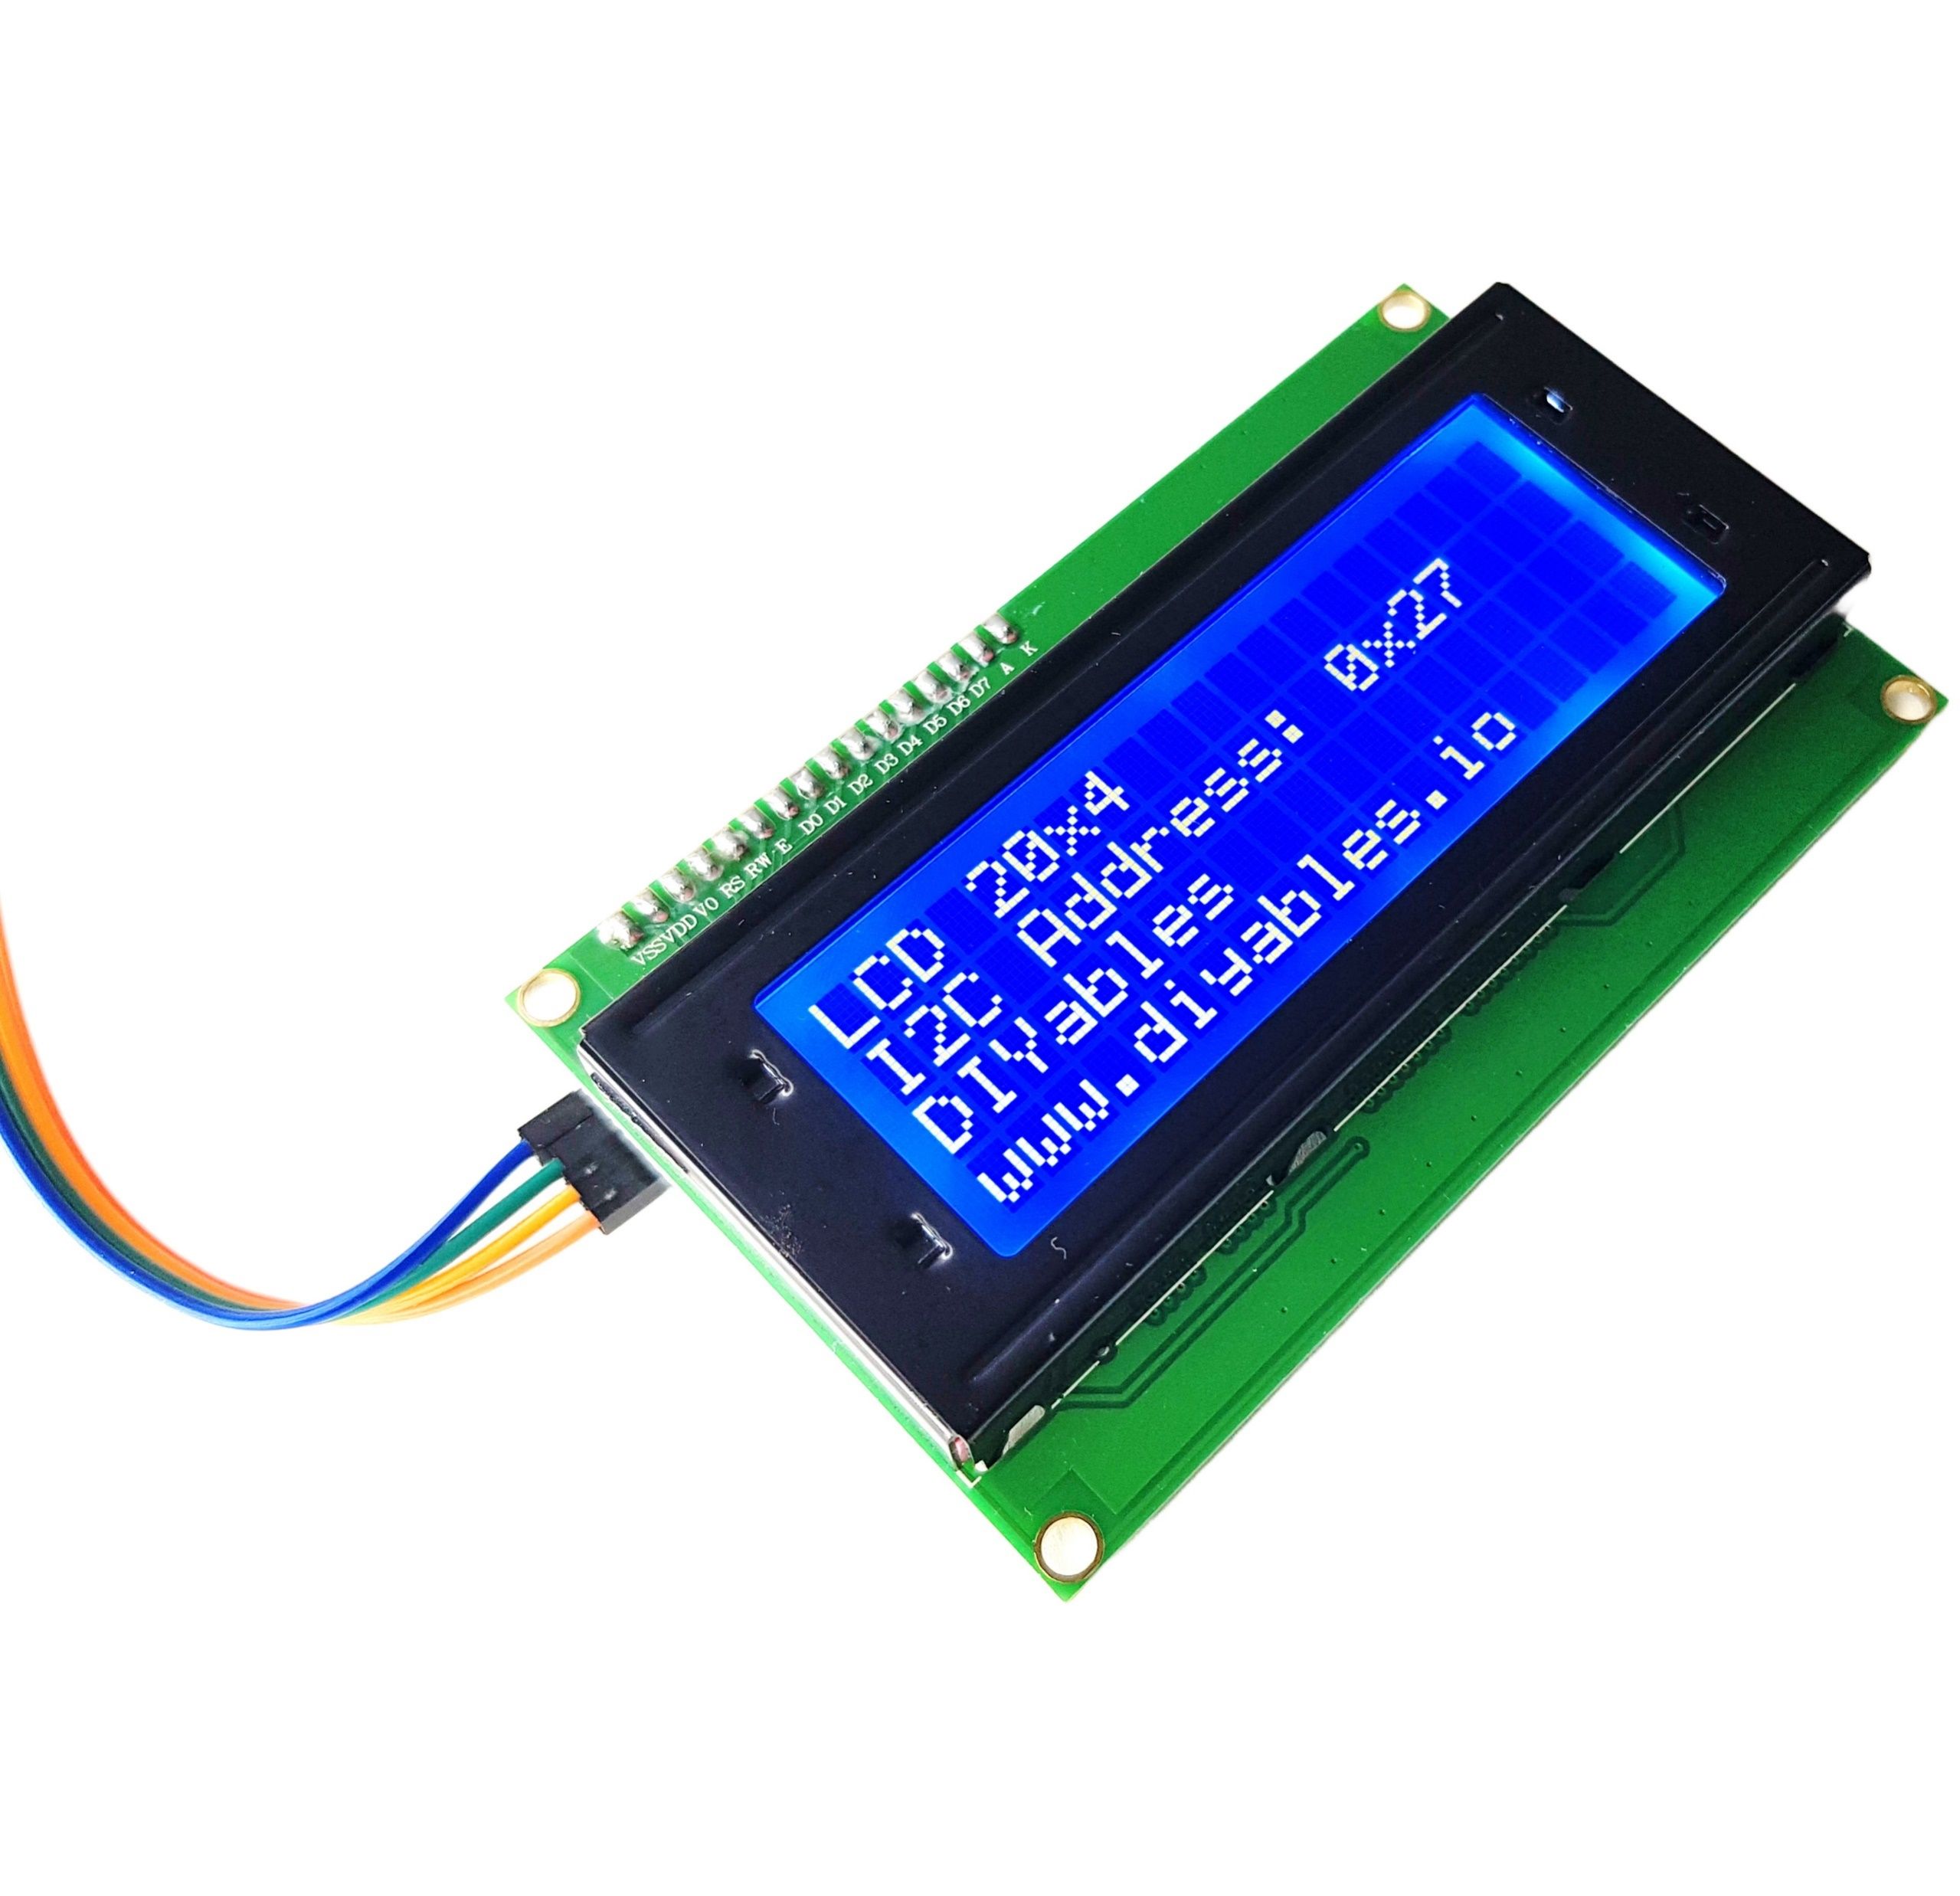
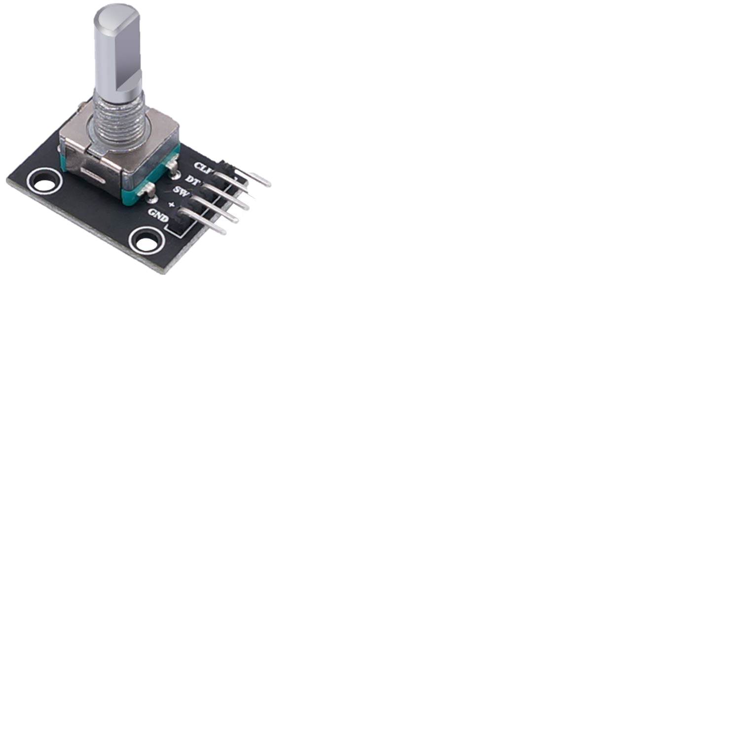
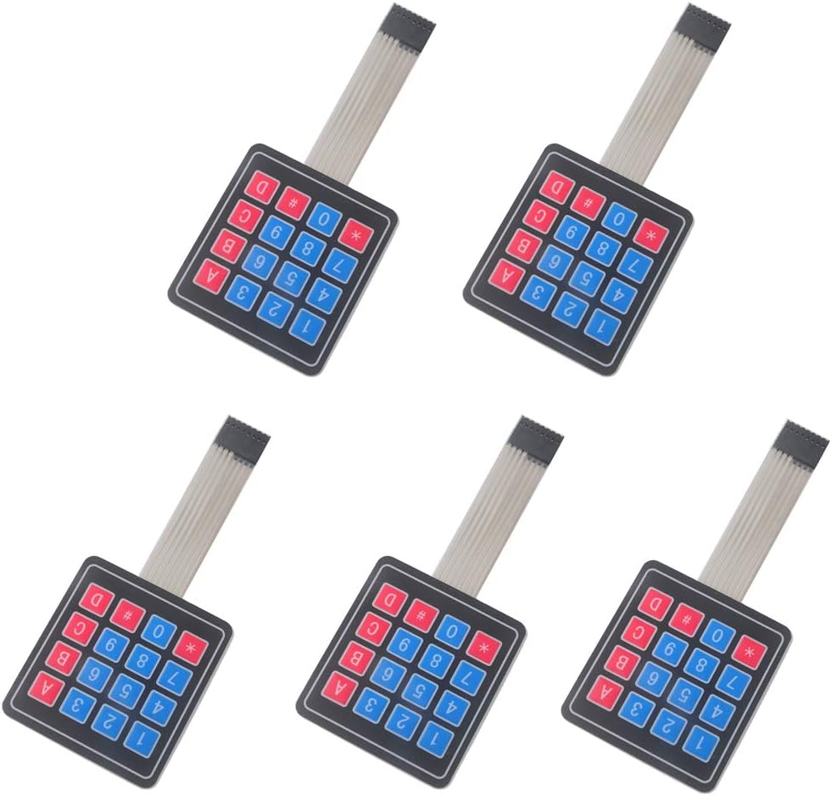
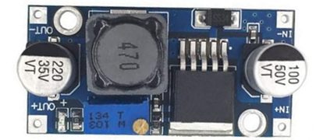
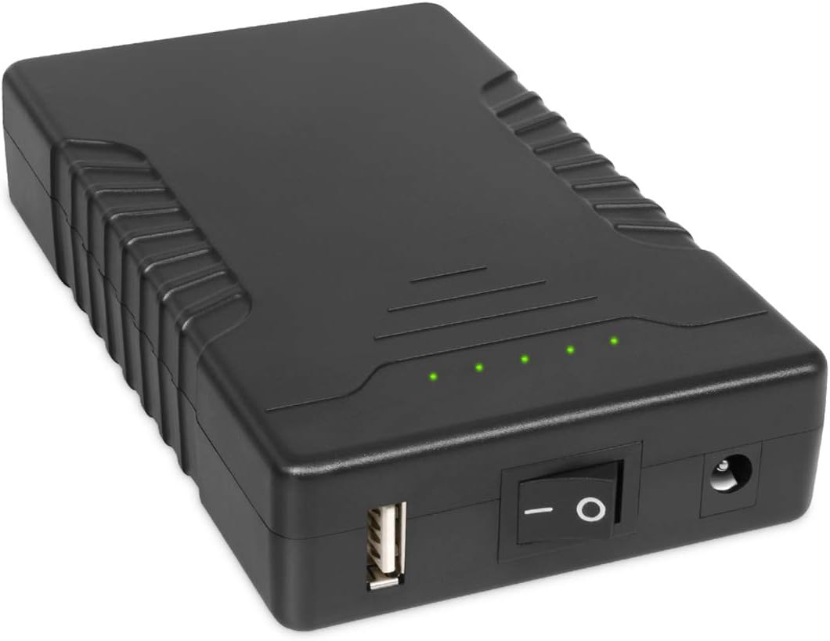
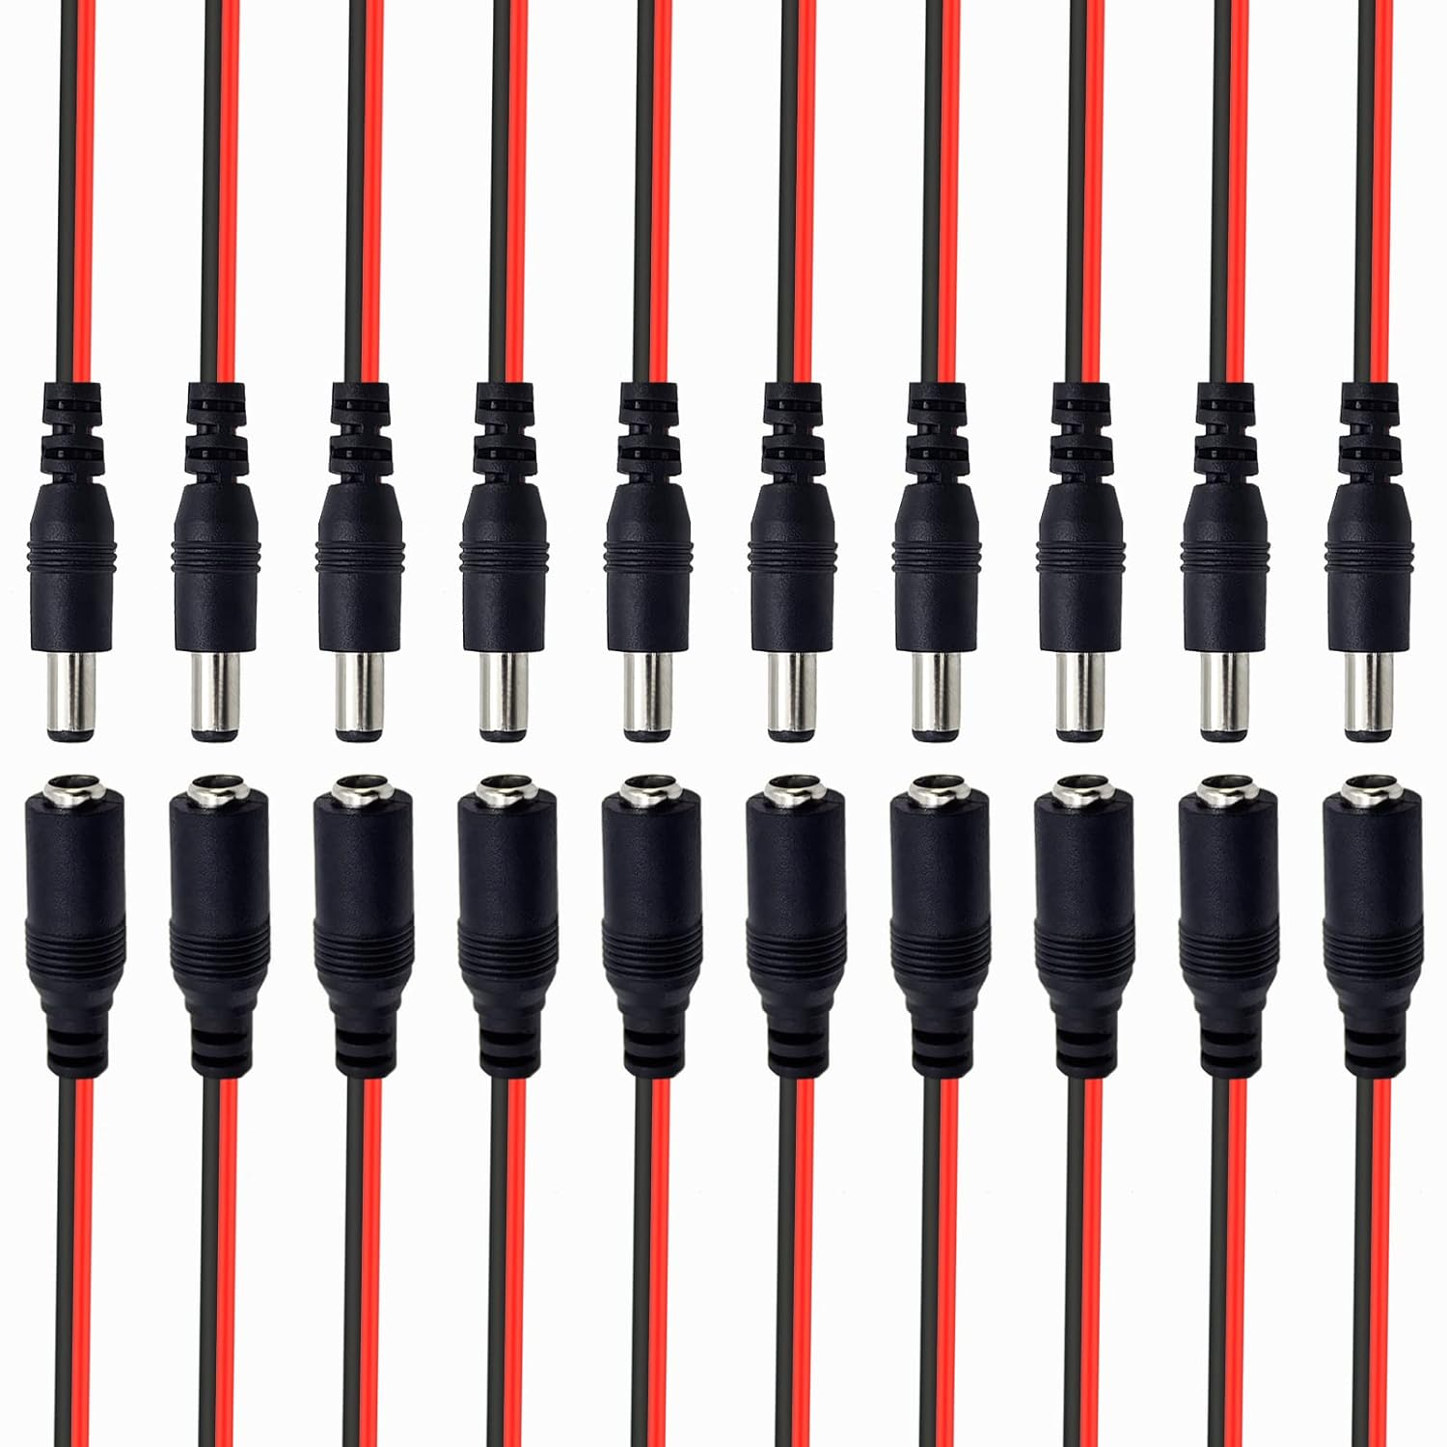
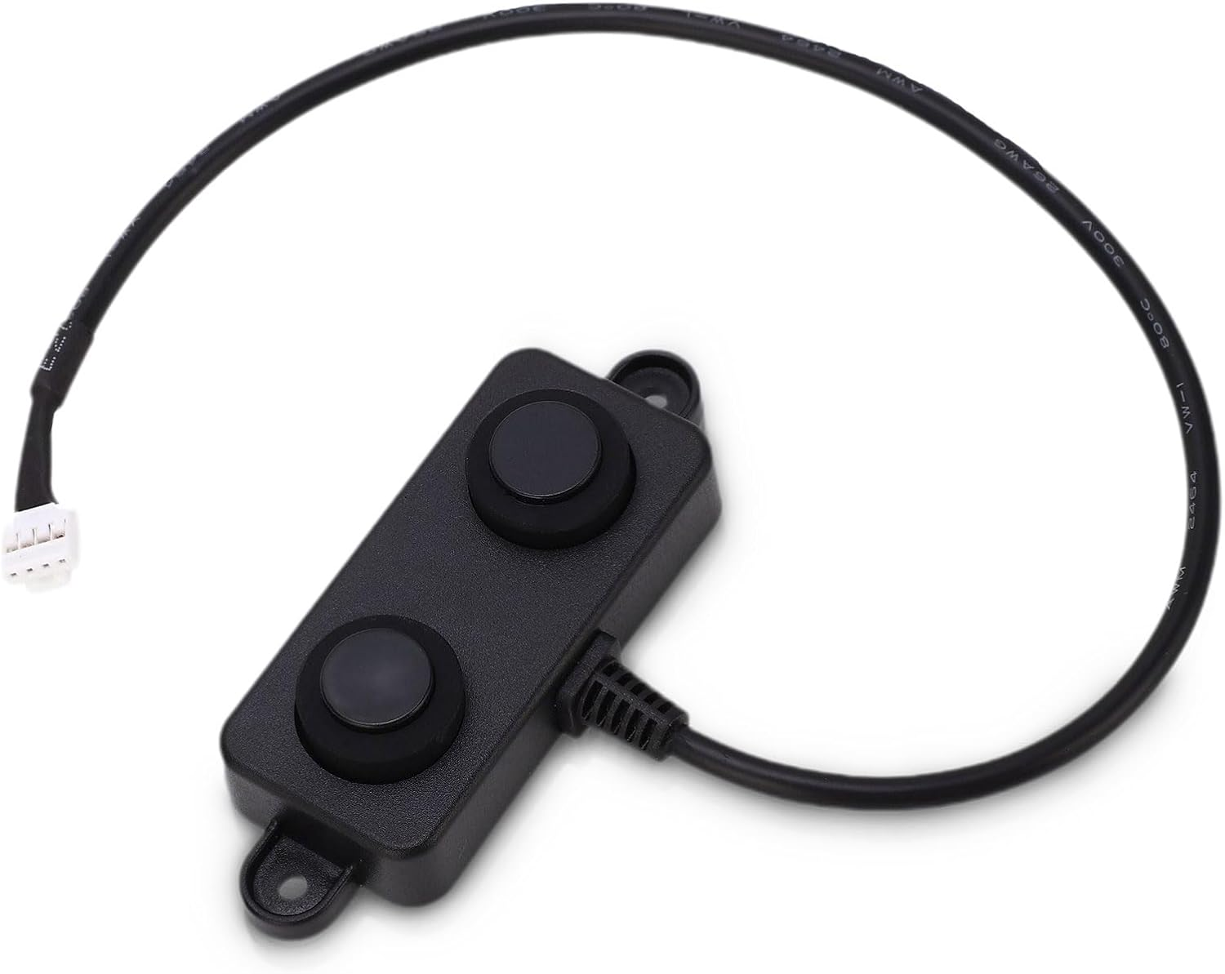
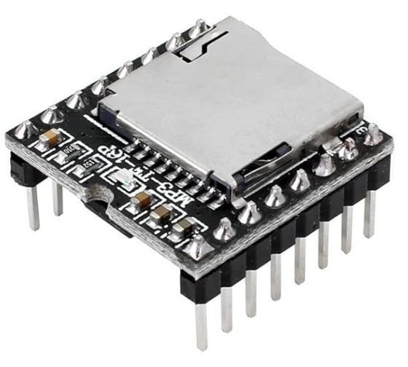
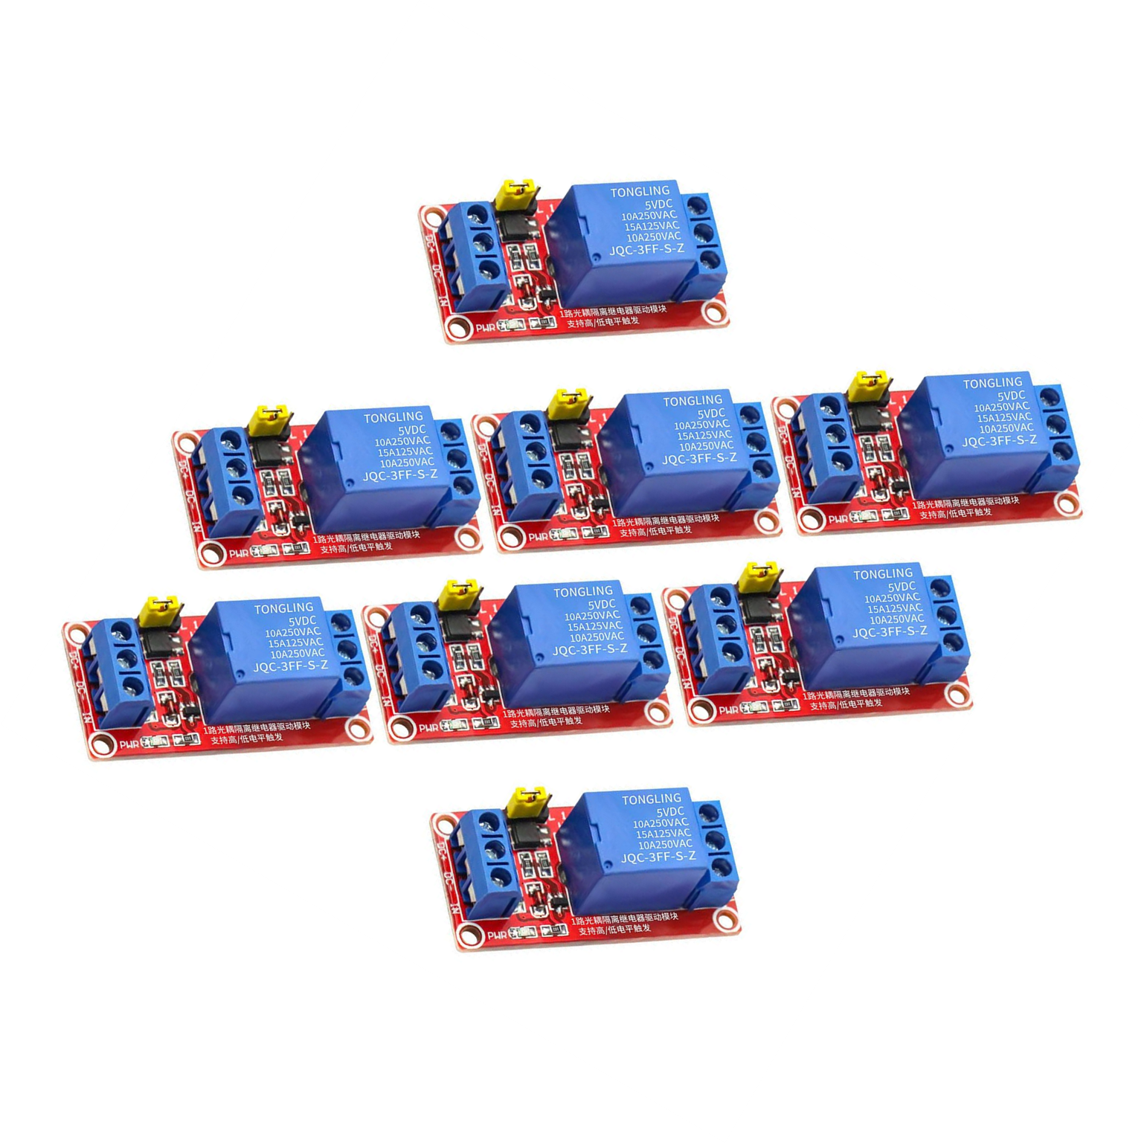
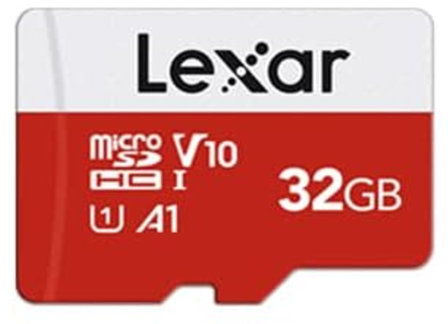
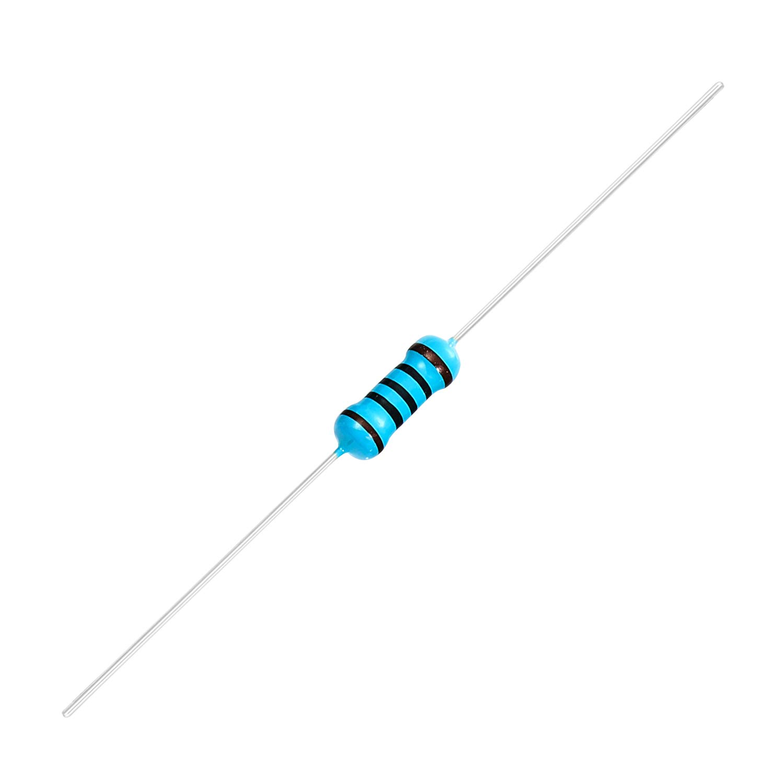
Hardware
Coordinator
Arduino nano × 1
XBee × 1
LCD × 1
Rotary Encoder × 1
Keypad × 1
Voltage regulator × 1
Battery × 1
Detector
Arduino nano × 1
XBee × 1
Distance sensor × 1
Speaker× 1
MP3 player × 1
Need a photo here
Need a photo here
Relay × 1
SD card × 1
Resistor 100 Ω × 1
Voltage regulator × 1
Battery × 1

Slide 6
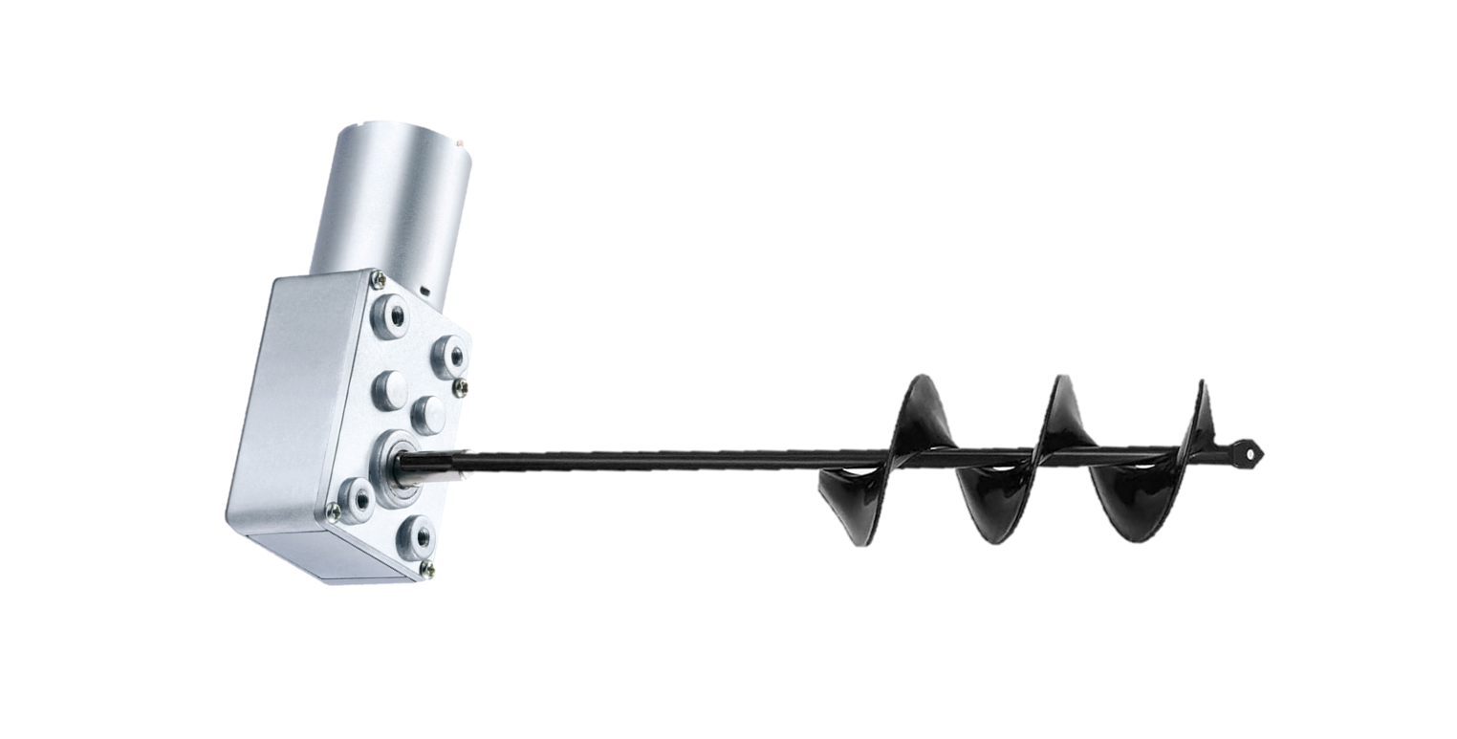
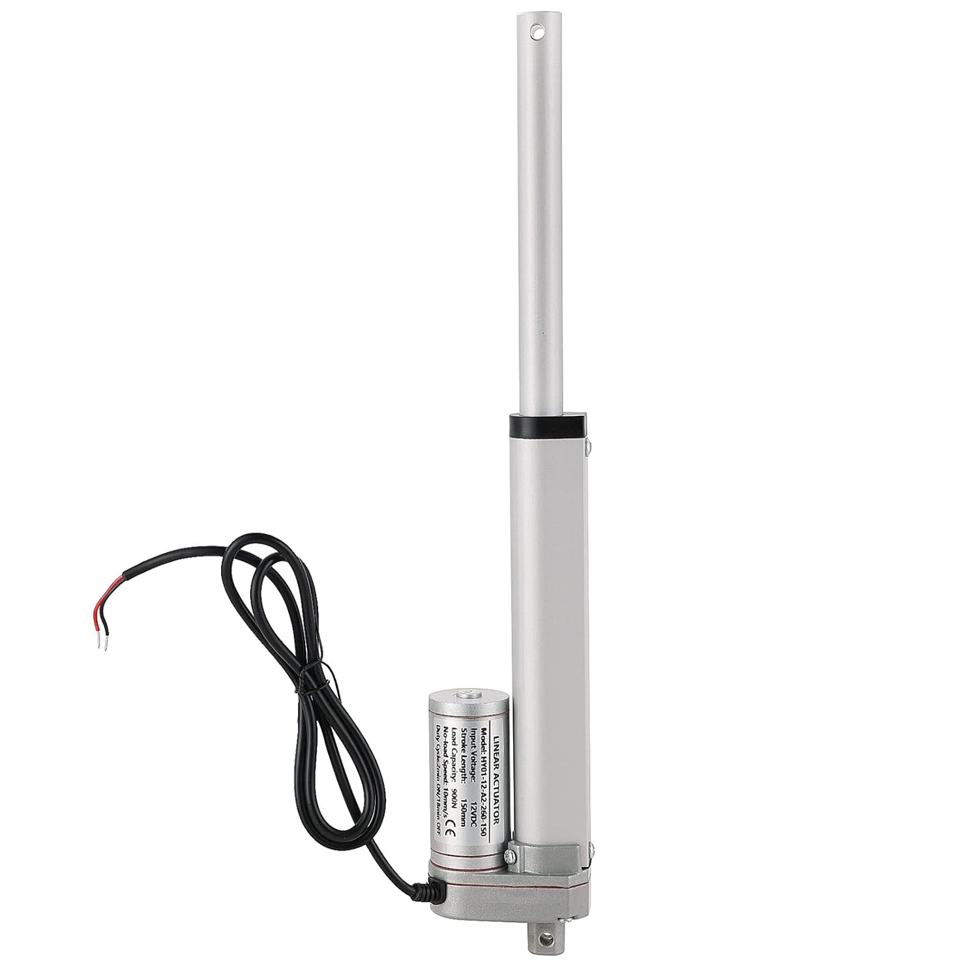
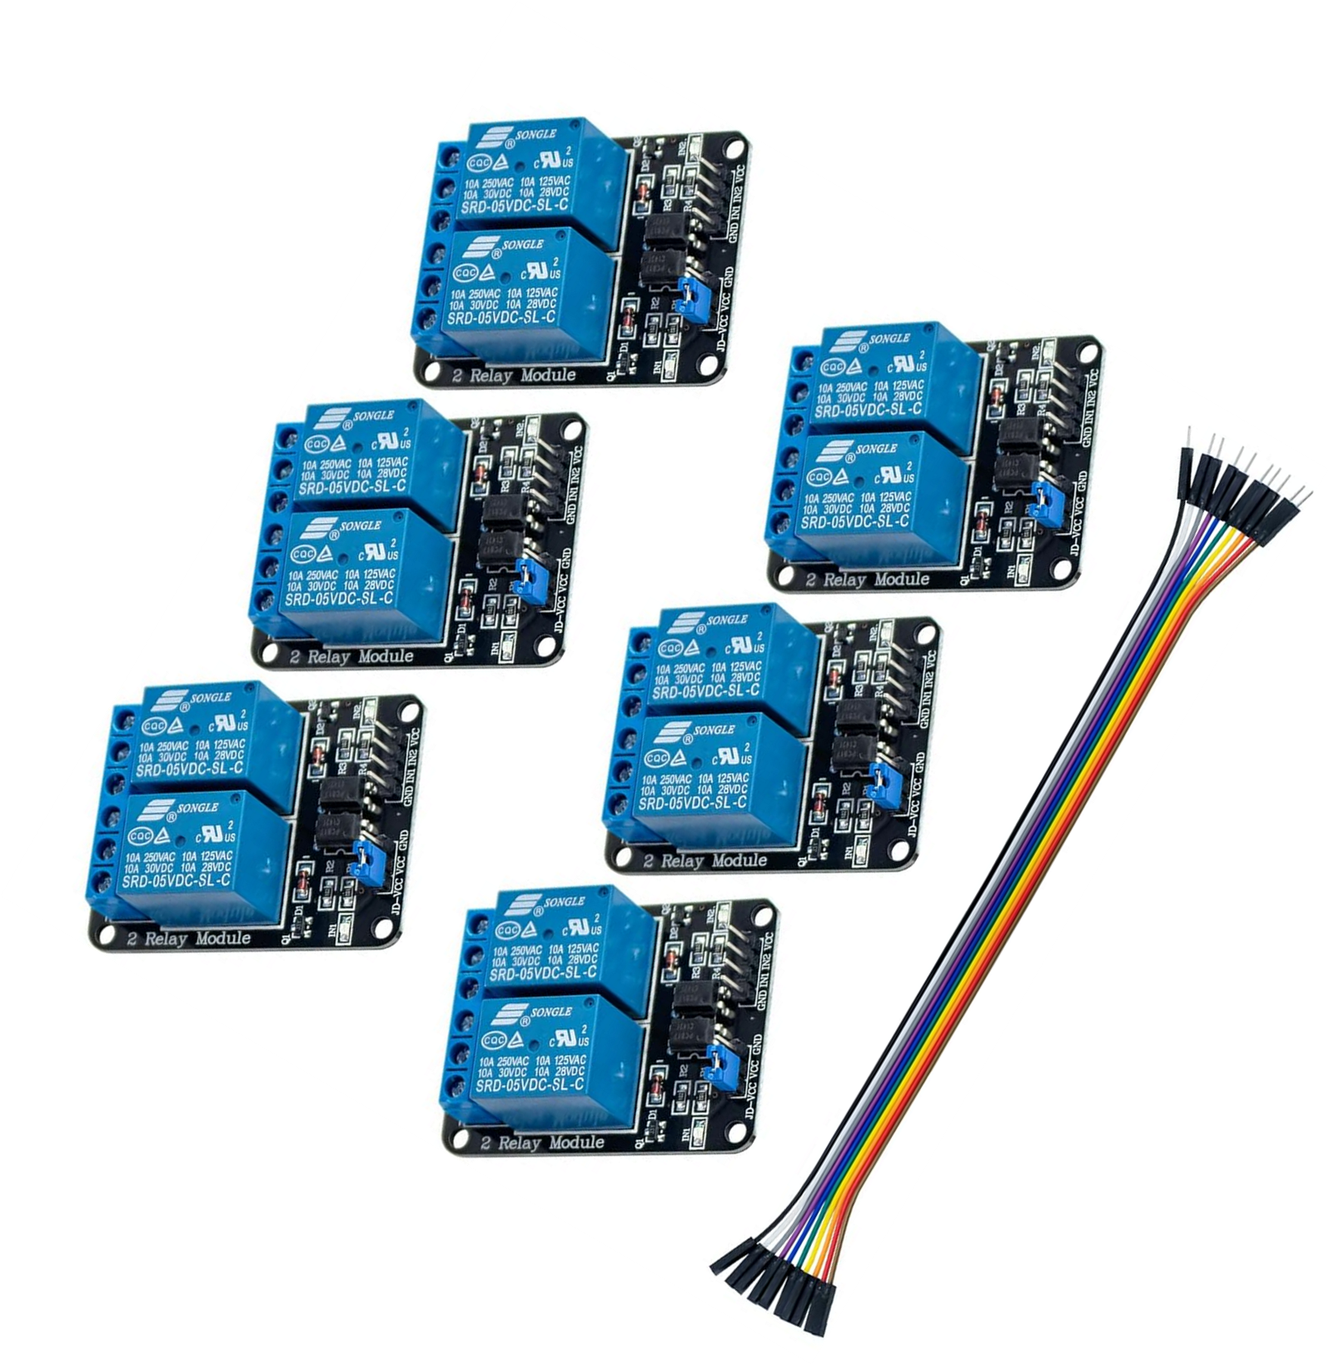
Hardware
Feeder
Arduino nano × 1
XBee × 1
Relay × 1
Actuator × 1
(Auger version)
Voltage regulator × 1
Battery × 1
or
(Linear actuator version)

Slide 7
Purchase log
Name | Link | Note
Arduino nano | Link
XBee | Link | Should all have the same series (e.g., S2C). Should try other series for long-distance communication.
XBee adapter | Link | Better to have both USB and Serial ports
Voltage regulator | Link
Battery | Link
DC power cable | Link
Liquid crystal displayer | Link | Should be 20 × 4, should have I2C adapter (a small circuit at the back)
Rotary encoder | Link
Keypad | Link | Should be 4 × 4
Distance sensor | Link | Should try RCWL-1670 as a cheap replacement
Speaker | Link
DFPlayer MP3 MP3-TF-16P | Link
SD card | Link
Relay (1 channel) | Link | Identify whether the relay is high or low level trigger. Adjust code accordingly.
Relay (2 channel) | Link
Resistor 100 Ω | Link

Slide 8
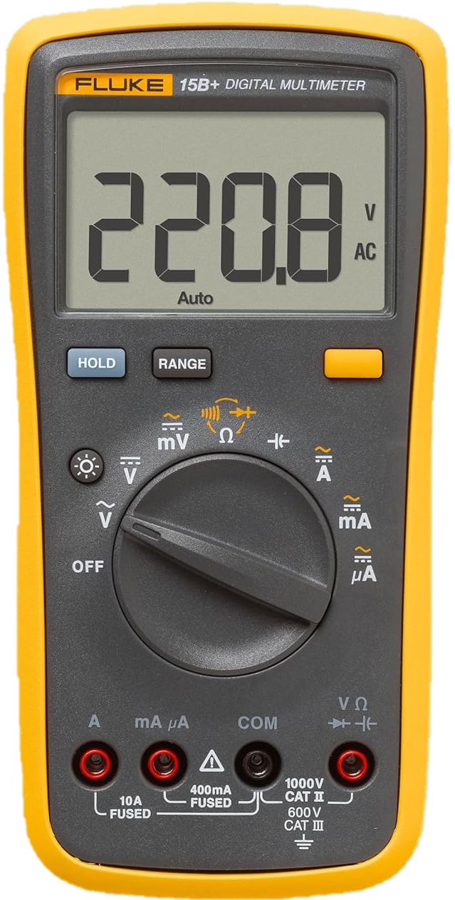
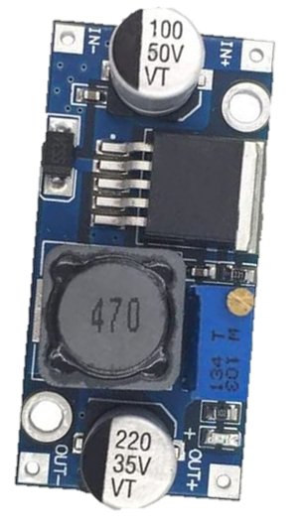
Hardware Preparation – Voltage Regulator
Do these for all voltage regulators before assembling the hardware.
Tune the resistor (yellow arrow) so that the output voltage is 5 volts.

Slide 9
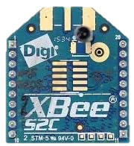
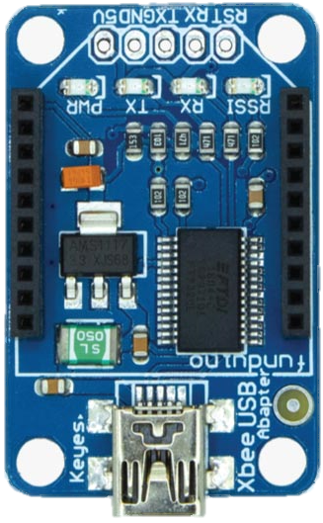
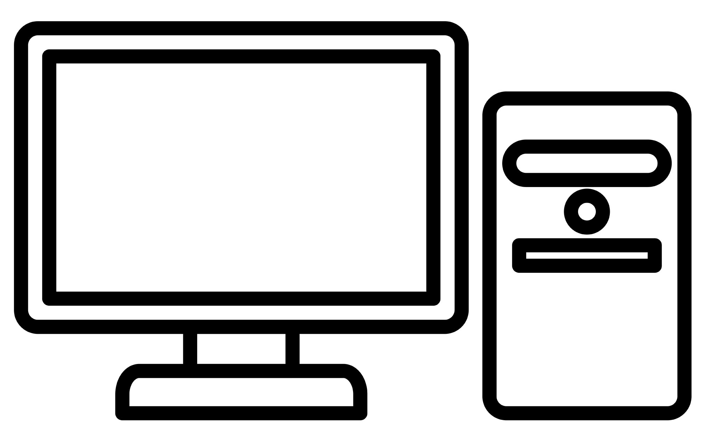
Hardware Preparation – XBee
Do these for all XBee modules before assembling the hardware.
Assemble the XBee chip (irregular shape) to the adaptor (regular shape)
Connect USB port to a PC
Follow this tutorial to initialize XBee: https://www.instructables.com/How-to-Use-XBee-Modules-As-Transmitter-Receiver-Ar/
Make sure that all the XBees share the same Channel but have different PAN ID.

Slide 10
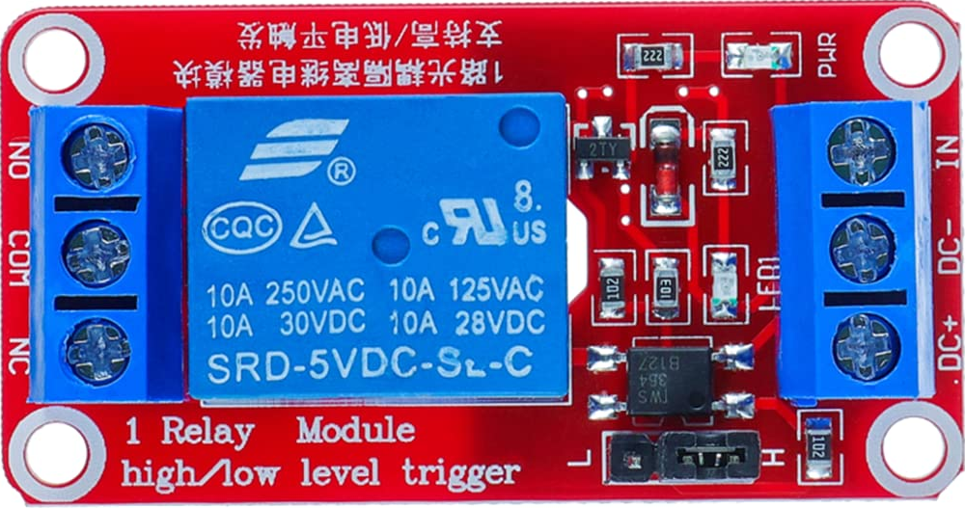
Hardware Preparation – Identifying Trigger Types
Do these for all relays:
Identify whether the relay is a high- or low-level trigger.
If it is adjustable, put the jumper on the low-level trigger.
If it is not adjustable, most relays are low-level triggers by default.
If it is a high-level trigger, revise the code accordingly (see later).

Slide 11
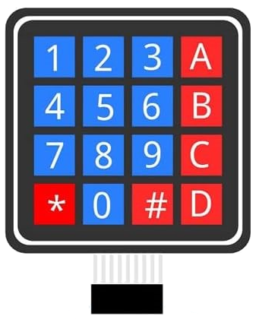
Hardware Preparation – Modifying Keypad
Paste stickers on the Keypad to change the keys.
OK
↑
←
→
↓

Slide 12
Hardware Preparation – SD card
Do these for all SD cards.
Add audio files.
Naming request for these files?

Slide 13
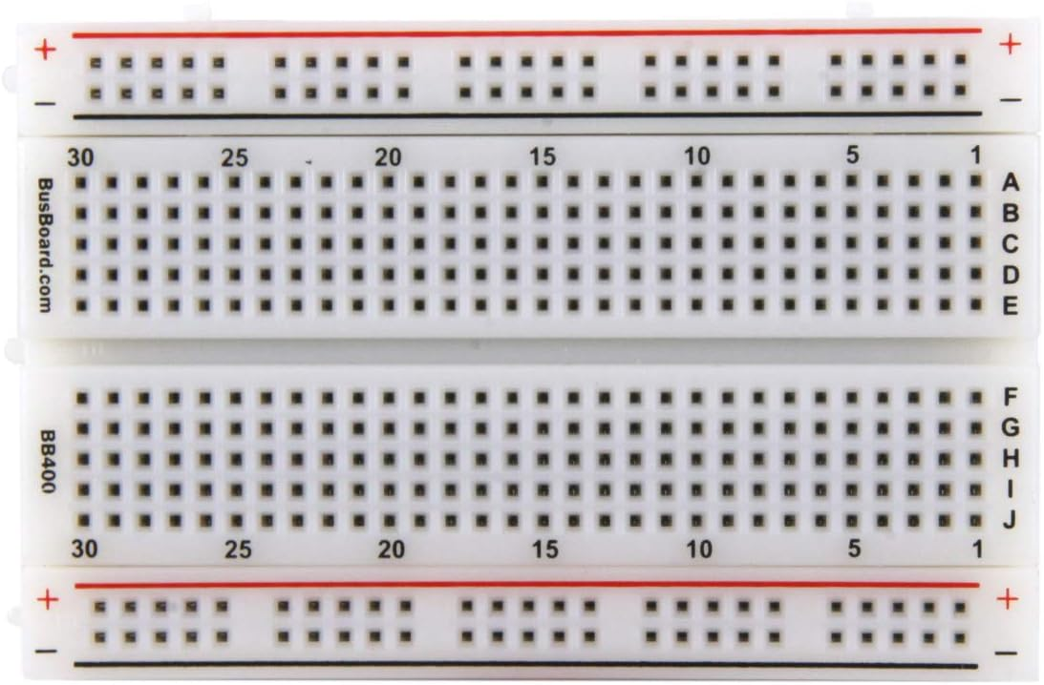
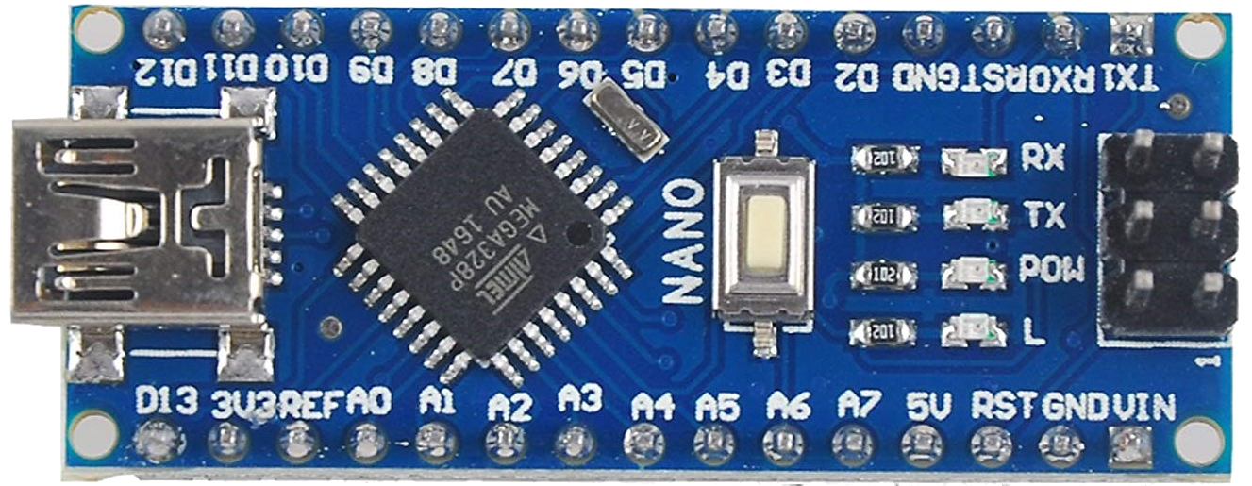
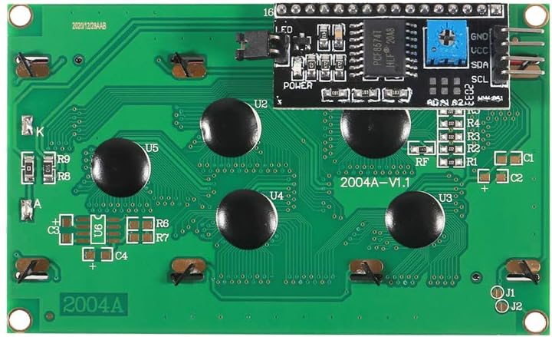
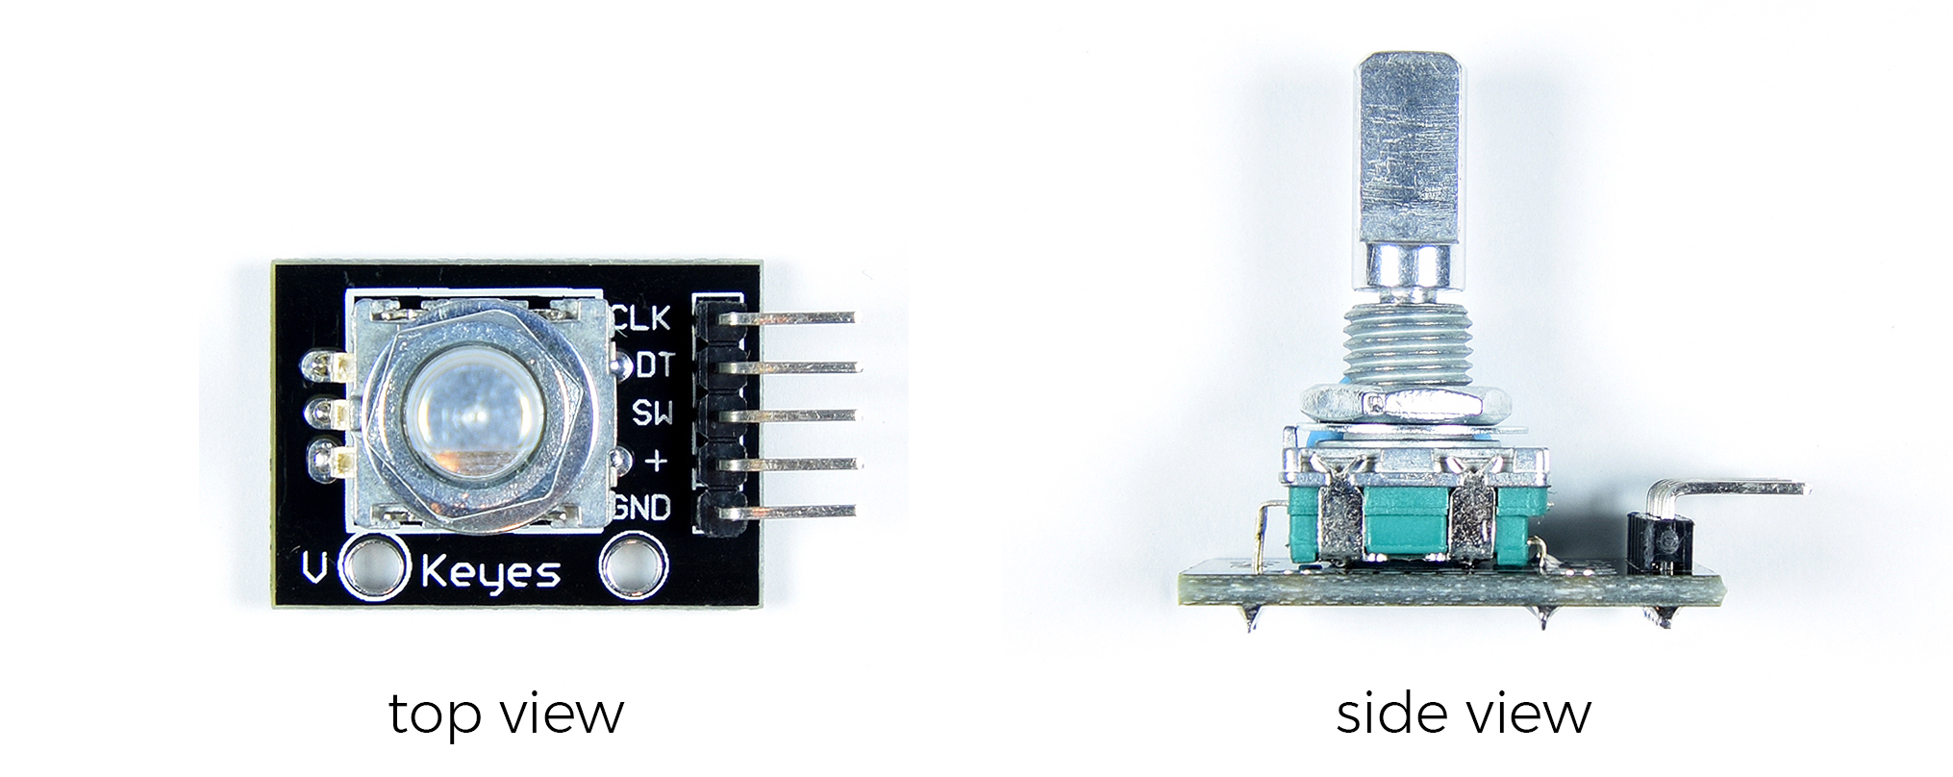
Wiring for Coordinator

Slide 14
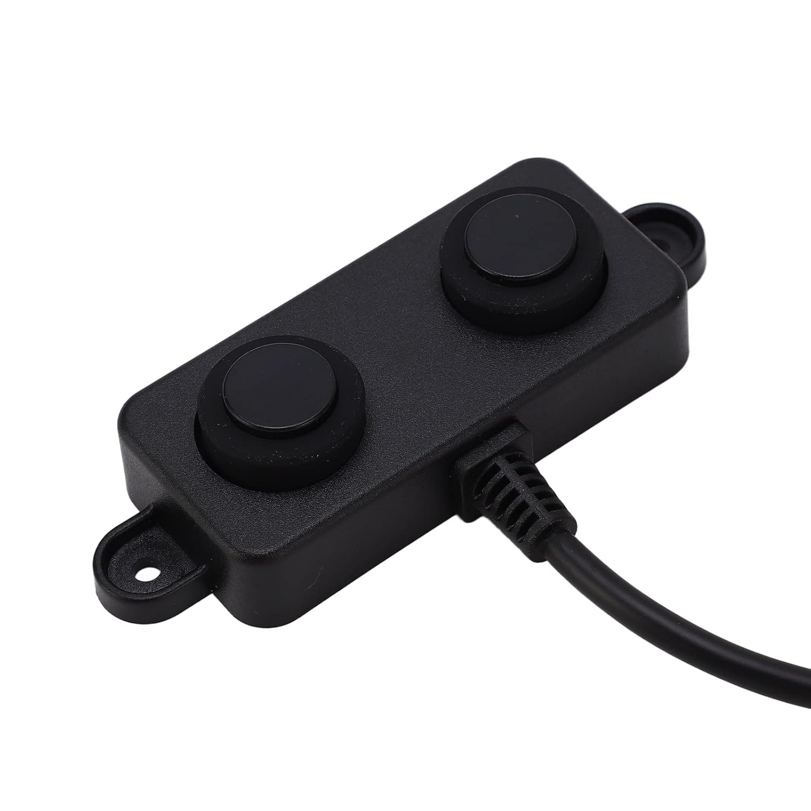
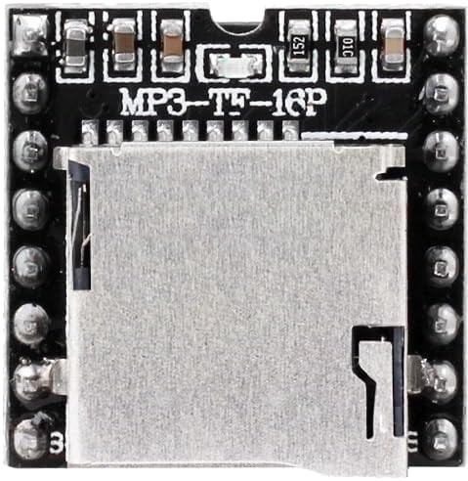
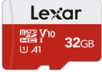
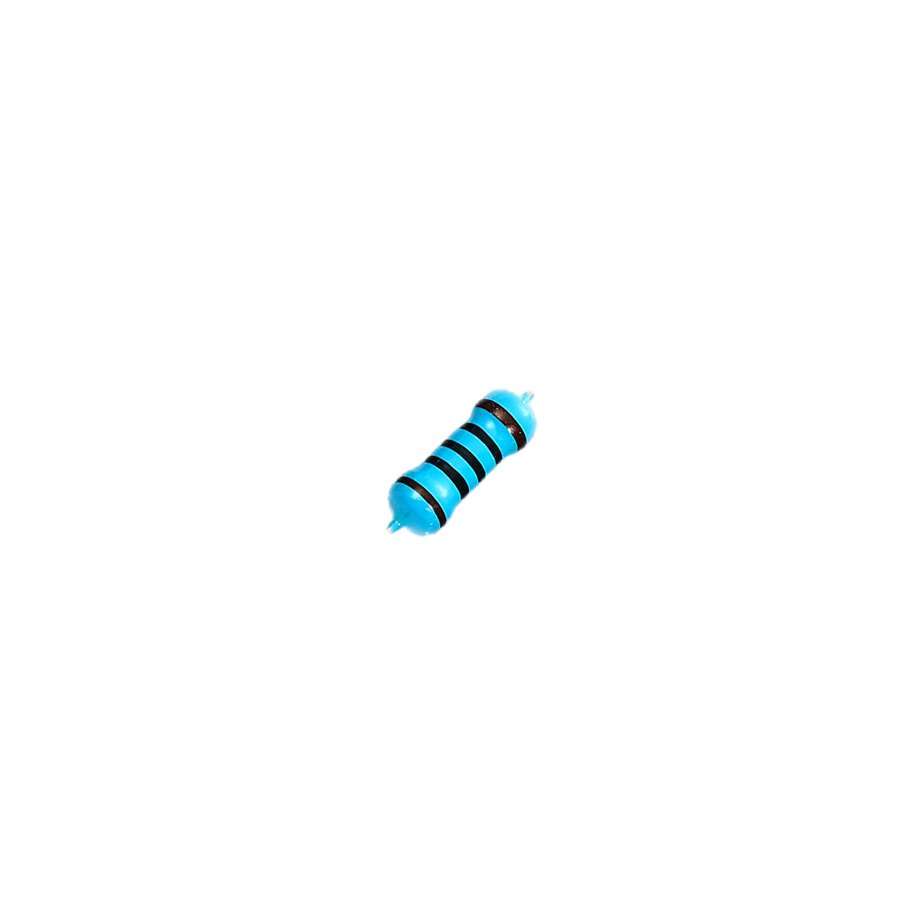
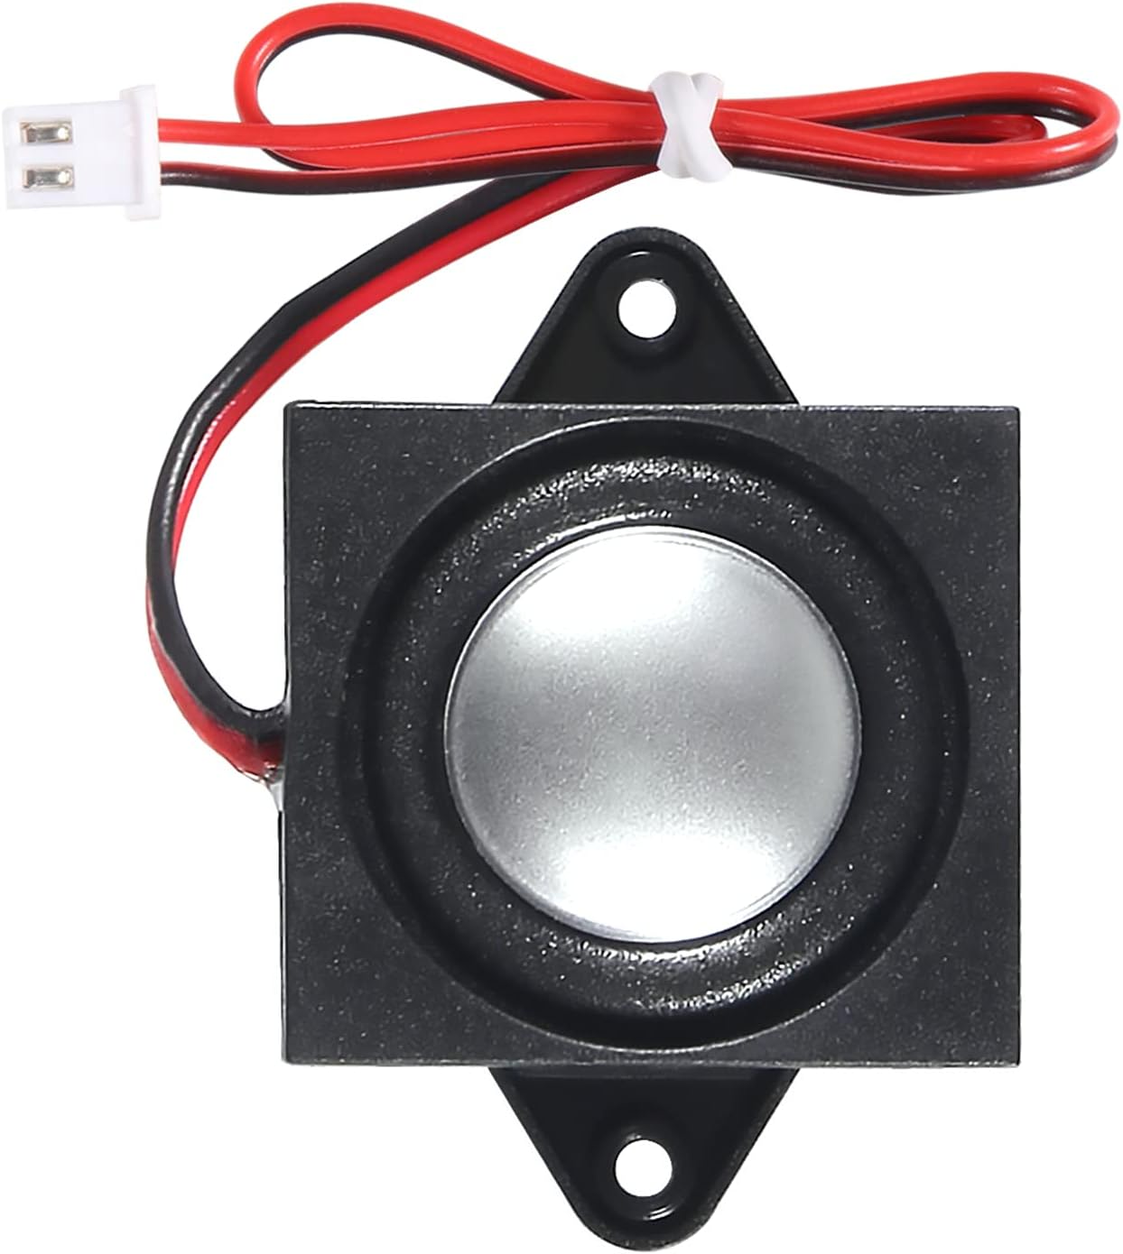
Wiring for Detector
Color code is important here

Slide 15
Wiring for Feeder (Auger Version)

Slide 16
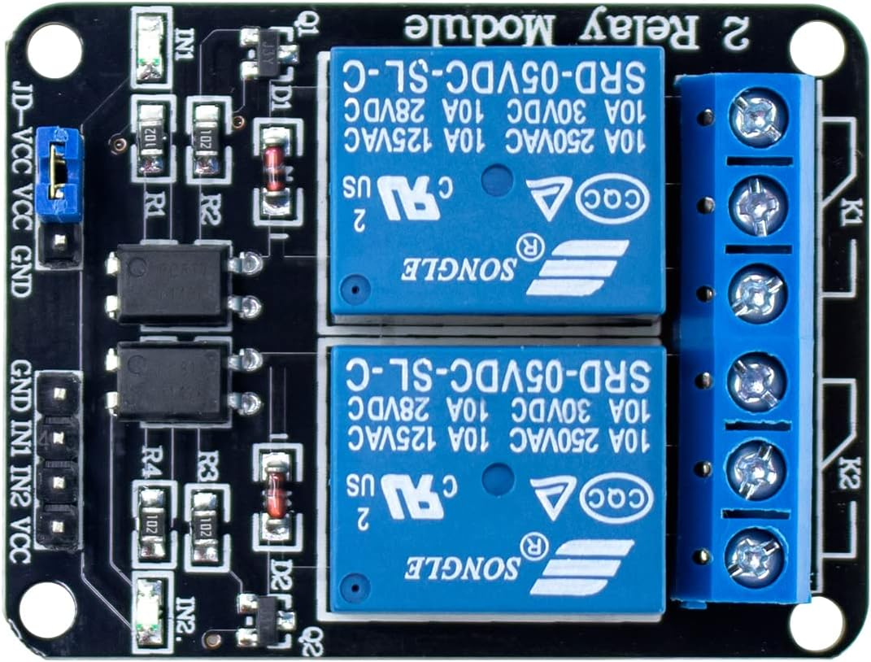
Wiring for Feeder (Linear Actuator Version)

Slide 17
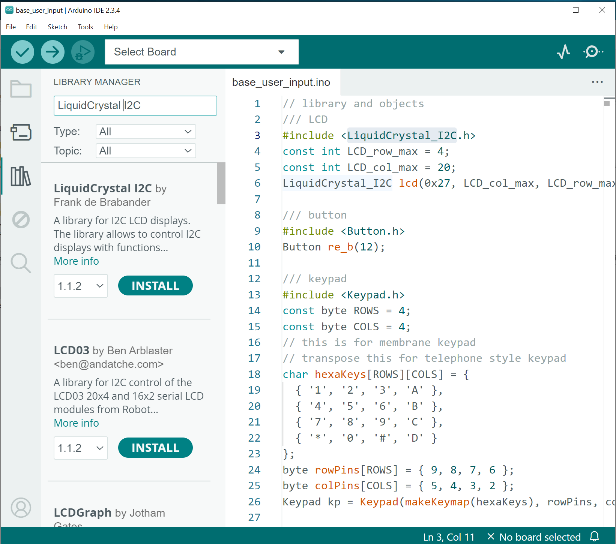
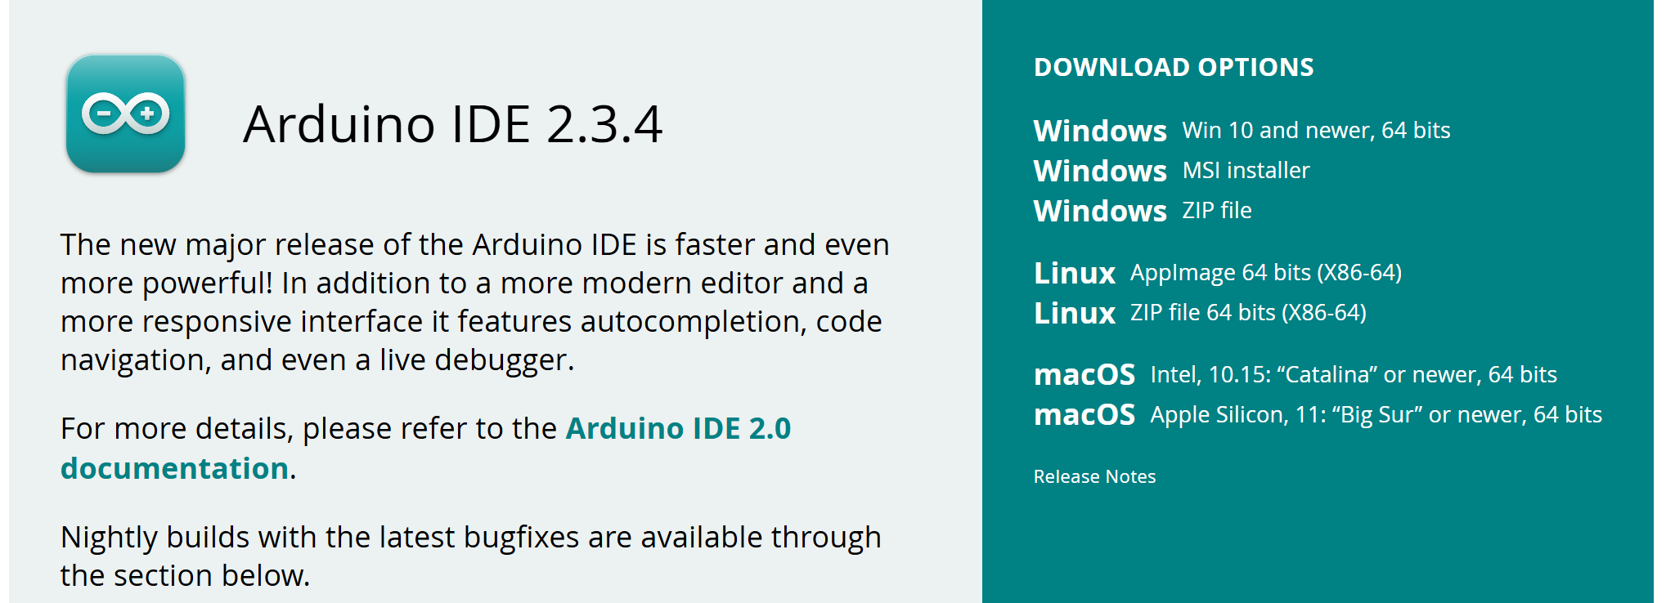
Software – Arduino
Download Arduino IDE 2.x.x installer: https://www.arduino.cc/en/software
Install Arduino IDE 2. Just use the default settings.
Open Arduino IDE. Whatever it asks your permission to install, allow them.
Install these libraries (and ):
Liquide Crystal I2C by Frrank de Brabander
Button by Michael Adams
Keypad by Mark Stanley et al
RotaryEncoder by Matthias Hertel
DFRobotDFPlayerMini by DFRobot
arduino-timer by Michael Contreras

Slide 18
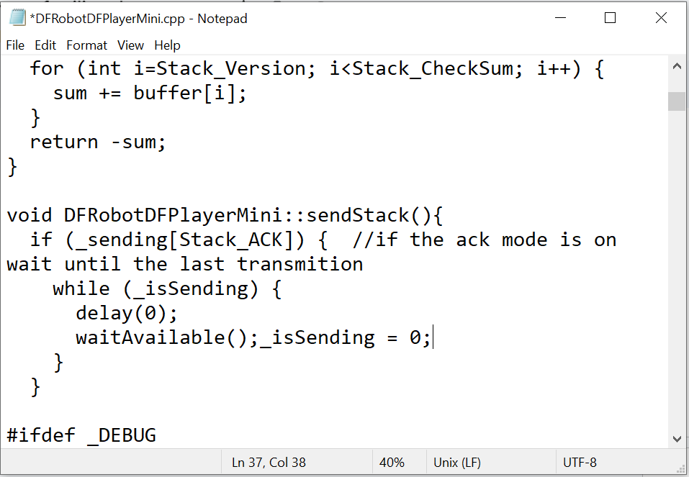
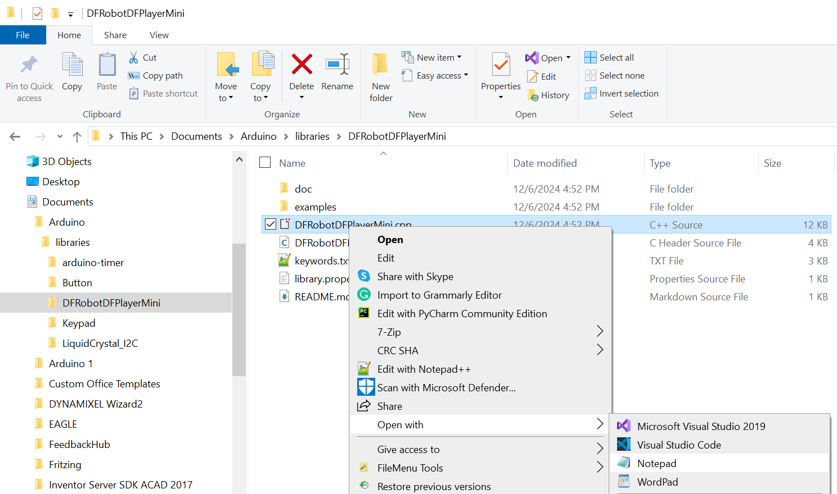
Software – Fixing Bugs in Library
For a library, DFRobotDFPlayerMini's current version (1.0.6) has some small bugs.
They may fix it in further versions.
Add "_isSending = 0;" at the end of line 37 in DFRobotDFPlayerMini.cpp.

Slide 19
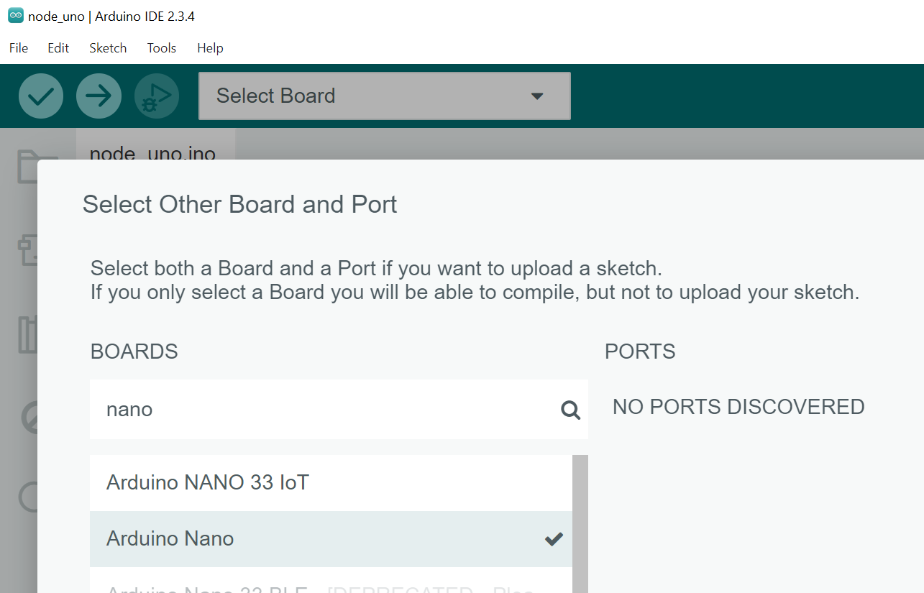
Software – Uploading Codes on Arduinos
Do these for all Arduinos:
Connect Arduino with the PC using USB.
Open the code using IDE
Coordinator: coordinator_nano.ino
Detector: detector_nano.ino
Feeder: feeder_nano.ino
Modify the code
Only modify the first few lines. Before “#include”.
Each detector and feeder should have a separate ID number, which should be a positive integer. For example, detector #1 and feeder #1 cannot be in the system together. Detector #0 is not OK.
Select board as nano
Upload code

Slide 20
Hardware – Adjusting LCD Backlight

Slide 21
Technical Documentation
For further development
Usually, you don’t need to know this

Slide 22
Communication Protocol
The messages are in fixed lengths to ensure reliable communication.
To simplify the network, each feeder node only communicates with the base nodes.
From coordinator to nodes: “<[node_ID, 3][cmd, 3][planned_timeout_sec, 4][planned_distance, 4]>”.
The numbers are digit numbers.
Node_ID: showing which node (detector or feeder) the coordinator wants to communicate to.
Cmd: command. 100: Detector tries to detect animal. 101: Feeder feeds once. Others: Doing nothing.
Planned_timeout_sec: the time span (unit: second) that the detector keeps monitoring before replying that the animal fails to move close. It is only useful for detectors.
Planned_distance: the distance (unit: mm) the animal is determined to have moved close. Only useful for detectors.
For example, <0011000300100> means the coordinator asks detector #1 to monitor if the animal moves closer than 100 mm in 30 seconds.
From nodes to coordinator: “<[coordinator_ID = 000, 3][node_ID, 3][is_success, 1]>”.
The numbers are digit numbers.
Coordinator_ID: Shows that the node wants to communicate with the base. It is always 000.
Node_ID: Showing which node initiated this communication.
Is_success: Showing whether the animal has moved close in time (detector) or the food ball has been released (feeder).
For example, <0000010> means that detector #1 has not identified that the animal moves close to the time threshold.

Slide 23
Range of Distance Detector

